Slide 1
Image Analysis

Slide 2
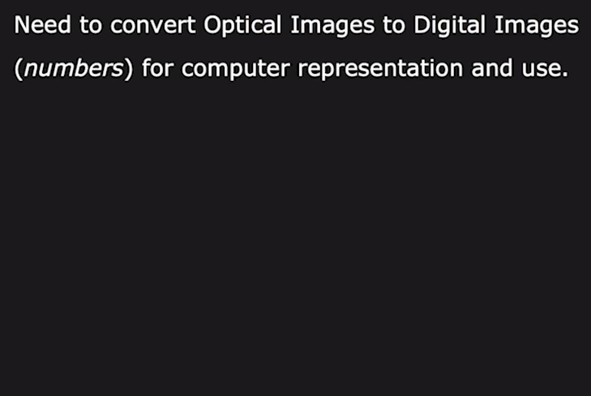
Image Sensing

Slide 3
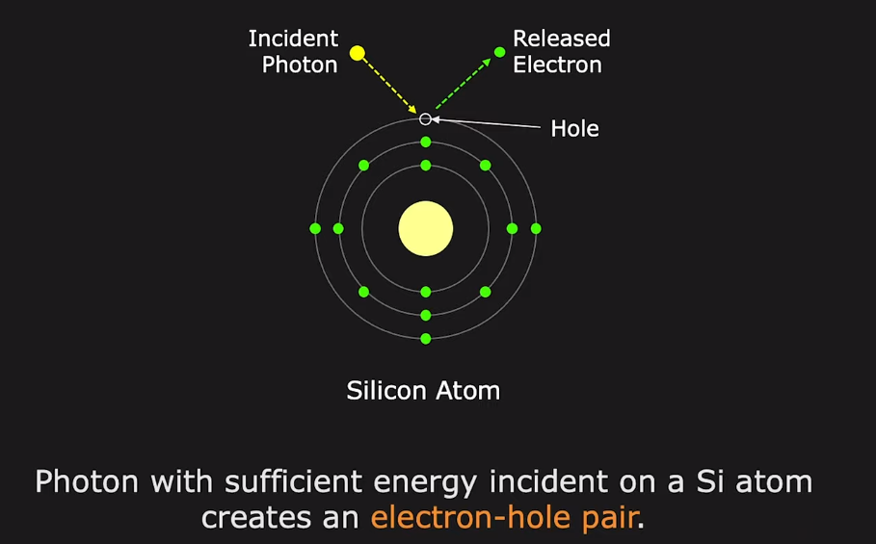
Converting light into Electric Charge

Slide 4
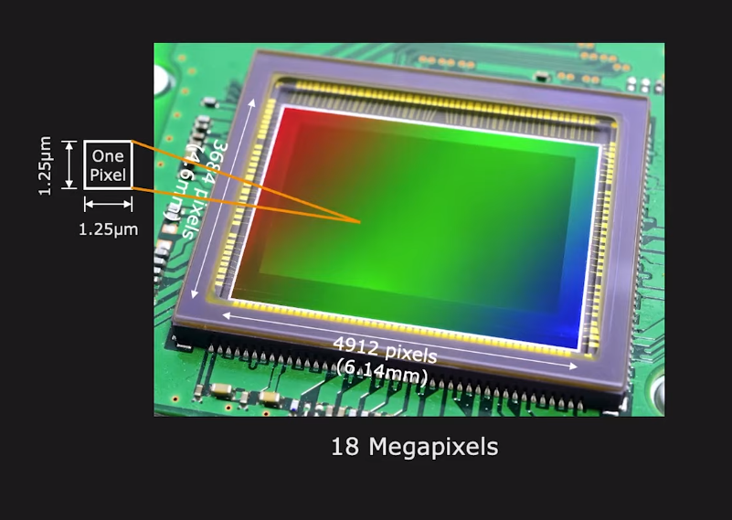
An Image Sensor

Slide 5
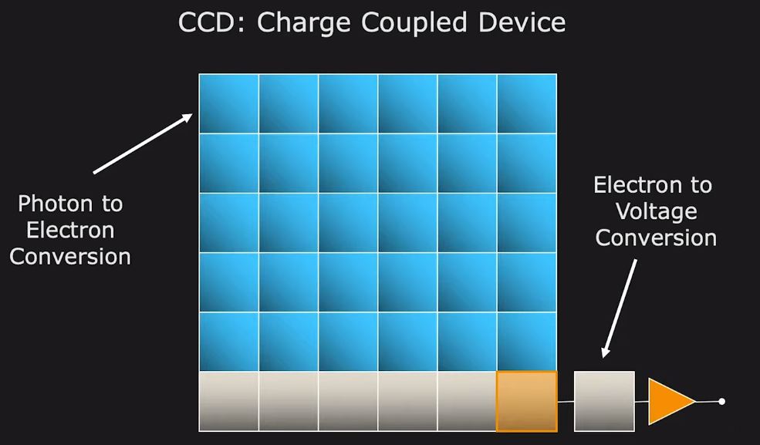
Types of Image Sensors- CCD

Slide 6
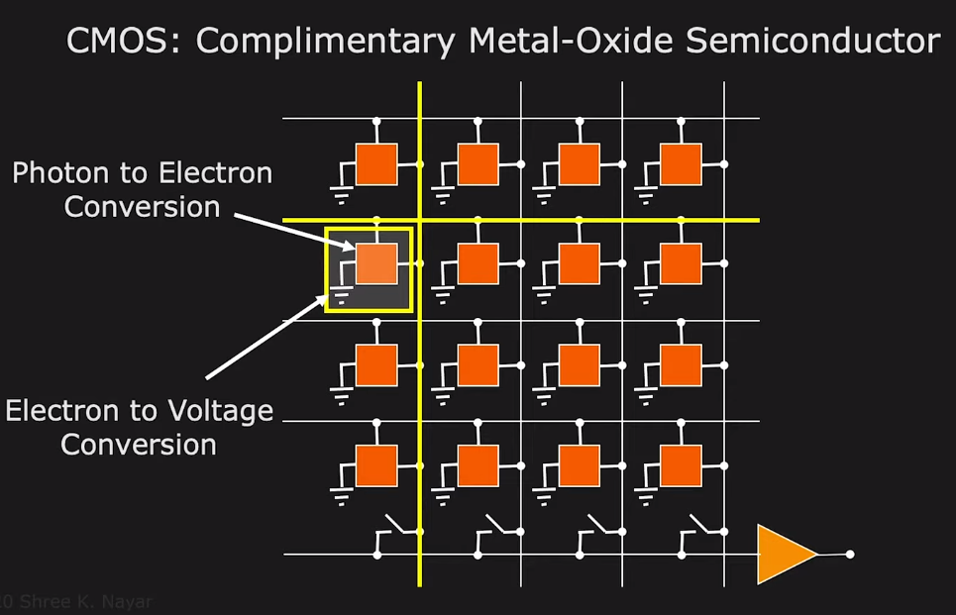
Types of Image Sensors- CMOS

Slide 7
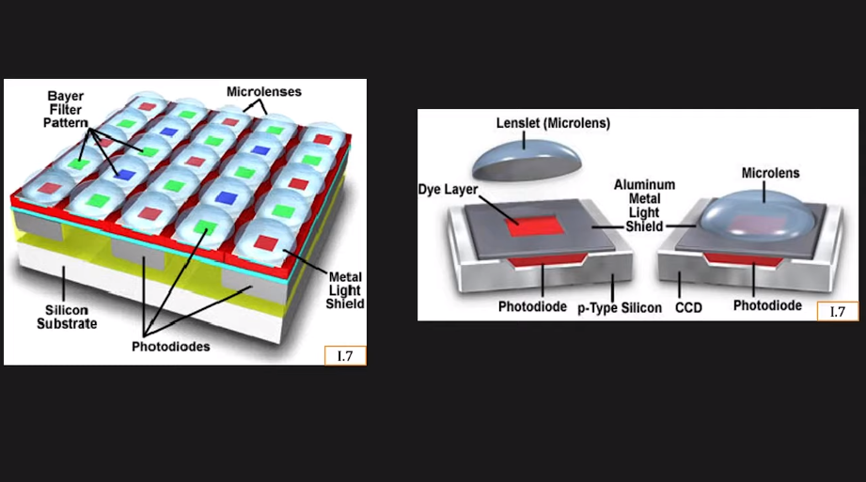
Image Sensor- A closer Look

Slide 8
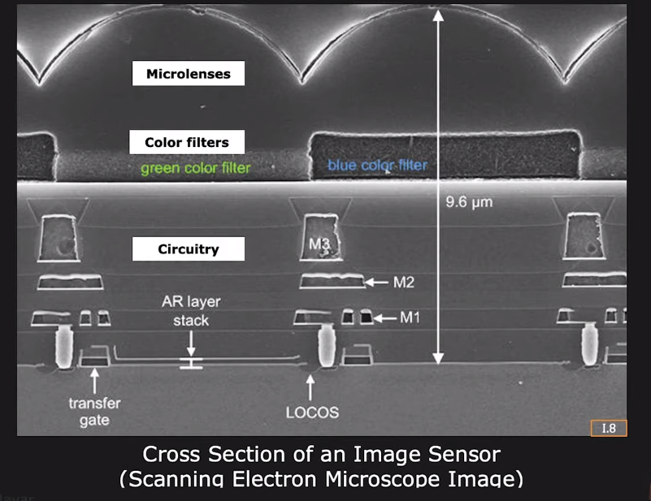
Image Sensor- A closer Look

Slide 9
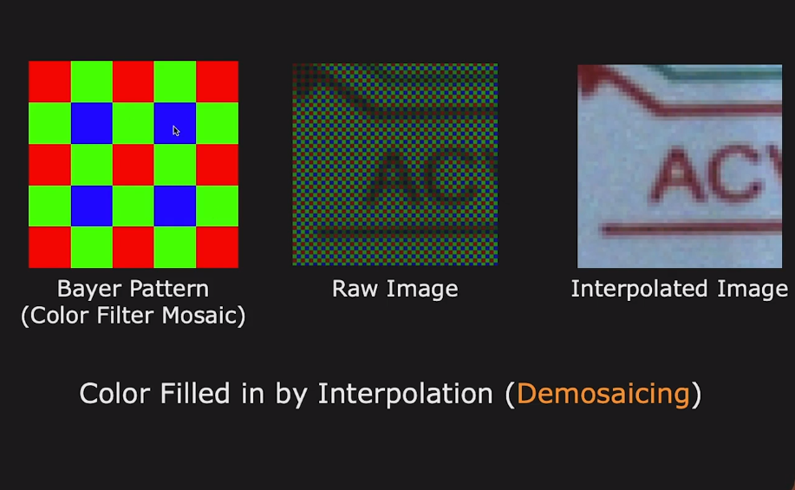
Sensing Color using Color Mosaic

Slide 10
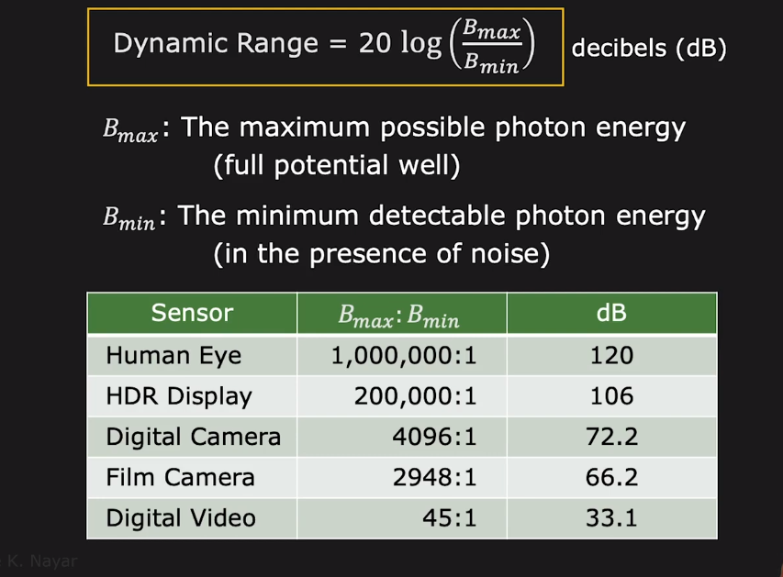
Sensor Dynamic Range

Slide 11
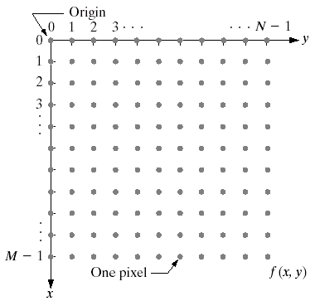
Image Representation
Before we discuss image acquisition recall that a digital image is composed of M rows and N columns of pixels each storing a value
Pixel values are most often grey levels in the range 0-255(black-white)
We will see later on that images can easily be represented as matrices
col
f (row, col)
row

Slide 12
Colored Image

Slide 13
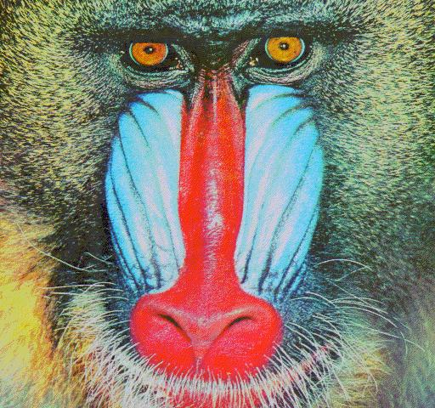

Colour images

Slide 14
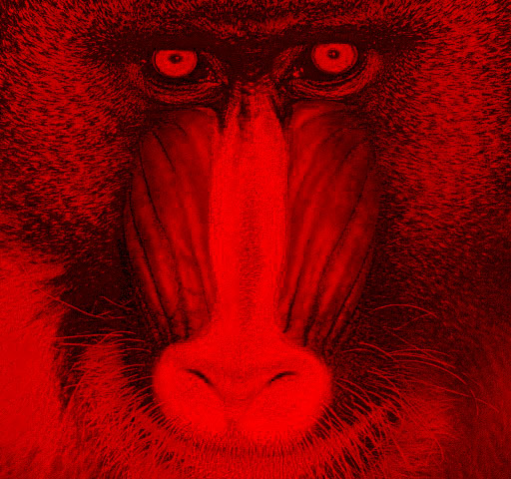
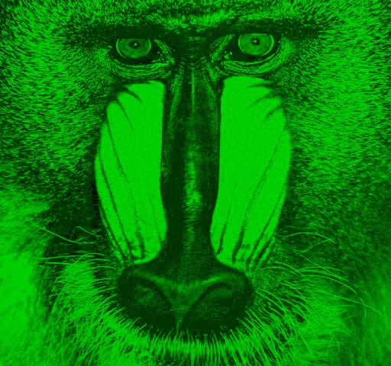
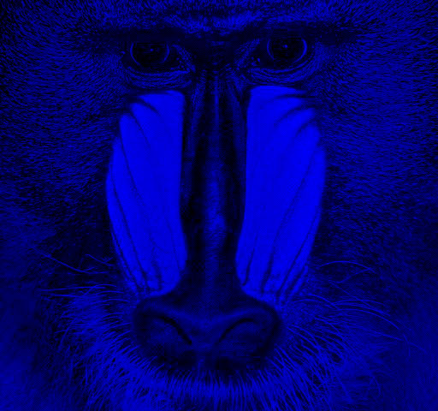
Colour images

Slide 15
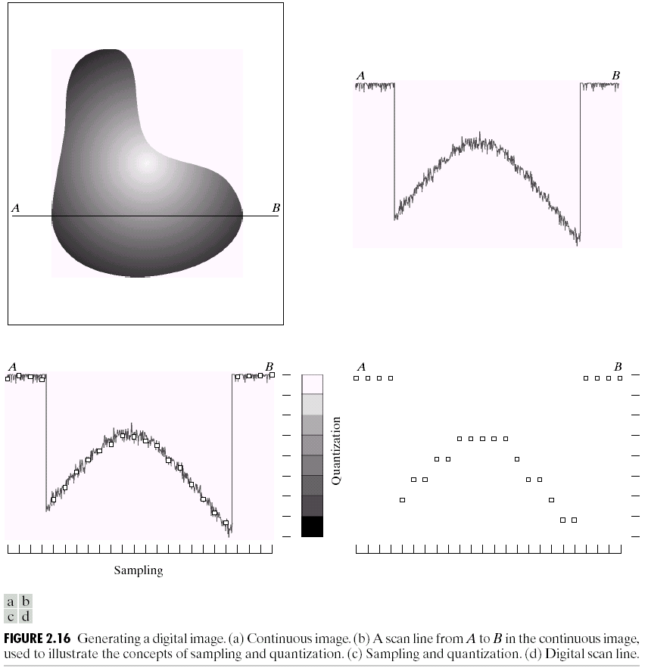
Image Sampling And Quantisation
A digital sensor can only measure a limited number of samples at a discrete set of energy levels
Quantisation is the process of converting a continuous analogue signal into a digital representation of this signal
Notes:
Analogue Vs digital
Think of the volume knob on your stereo
Records Vs CDs Vs Mp3s
Nyquist theory etc talks about how much sampling we need to do

Slide 16
Image Sampling And Quantisation
Notes:
Analogue Vs digital
Think of the volume knob on your stereo
Records Vs CDs Vs Mp3s
Nyquist theory etc talks about how much sampling we need to do

Slide 17
Image Sampling And Quantisation
Notes:
Analogue Vs digital
Think of the volume knob on your stereo
Records Vs CDs Vs Mp3s
Nyquist theory etc talks about how much sampling we need to do

Slide 18

Image Sampling And Quantisation (cont…)
Remember that a digital image is always only an approximation of a real world scene

Slide 19
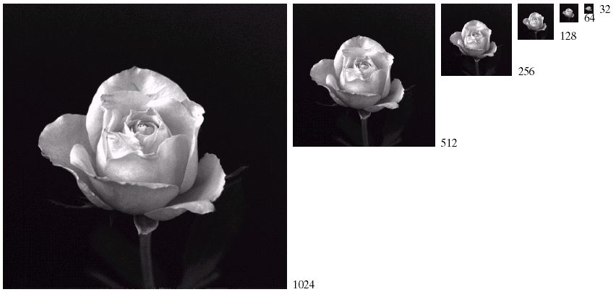
Spatial Resolution (cont…)

Slide 20
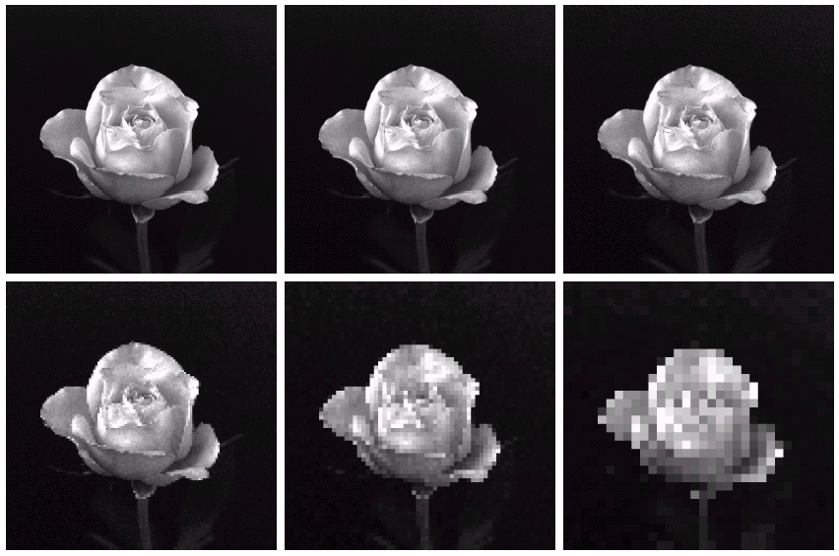
Spatial Resolution (cont…)
1024 * 1024
512 * 512
256 * 256
128 * 128
64 * 64
32 * 32

Slide 21
Intensity Level Resolution
Intensity level resolution refers to the number of intensity levels used to represent the image
The more intensity levels used, the finer the level of detail discernable in an image
Intensity level resolution is usually given in terms of the number of bits used to store each intensity level
Number of Bits
Number of Intensity Levels
Examples
1
2
0, 1
2
4
00, 01, 10, 11
4
16
0000, 0101, 1111
8
256
00110011, 01010101
16
65,536
1010101010101010

Slide 22
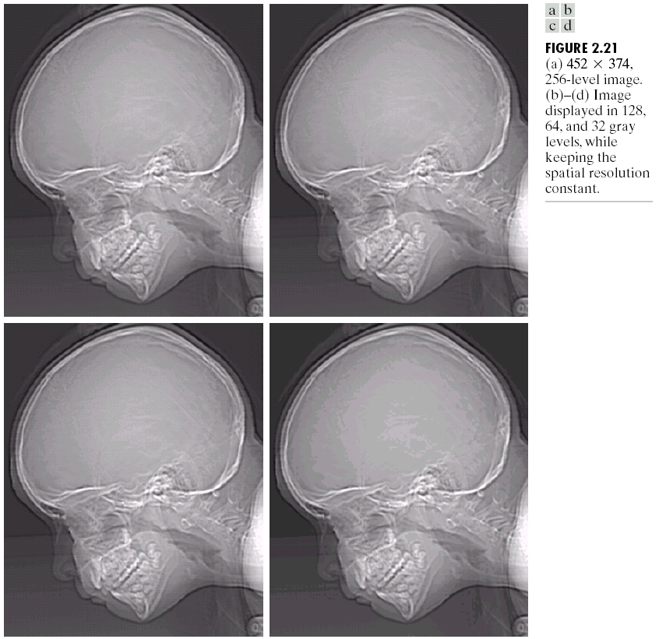
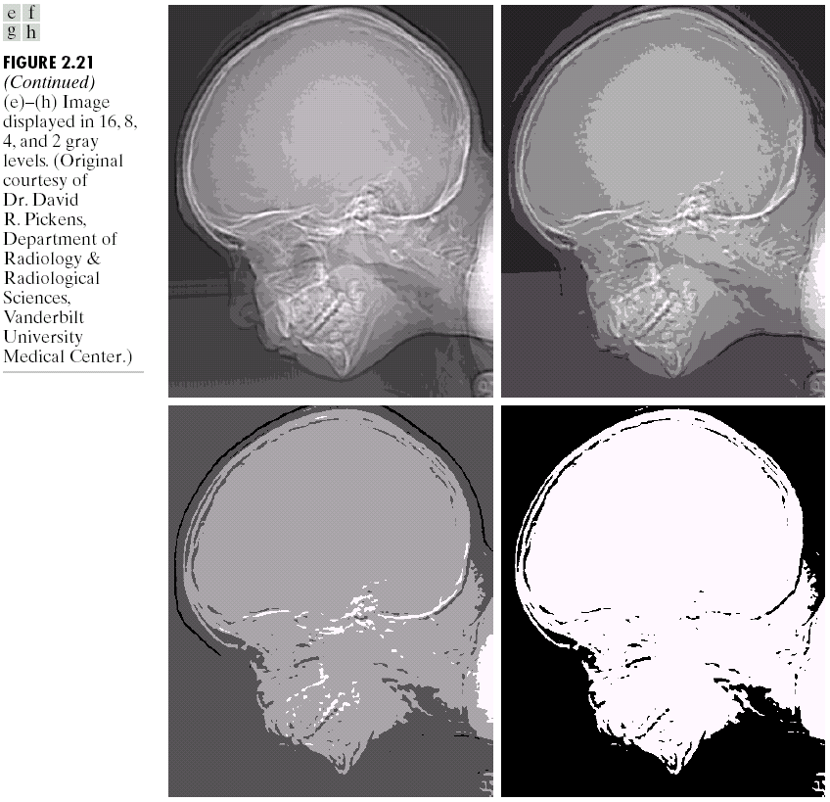
Intensity Level Resolution (cont…)
256 grey levels (8 bits per pixel)
128 grey levels (7 bpp)
64 grey levels (6 bpp)
32 grey levels (5 bpp)
16 grey levels (4 bpp)
8 grey levels (3 bpp)
4 grey levels (2 bpp)
2 grey levels (1 bpp)

Slide 23
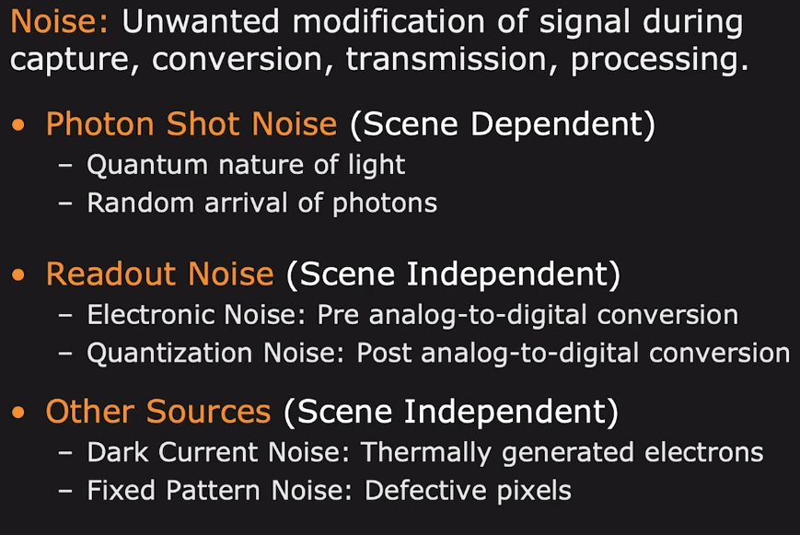
Image Noises

Slide 24
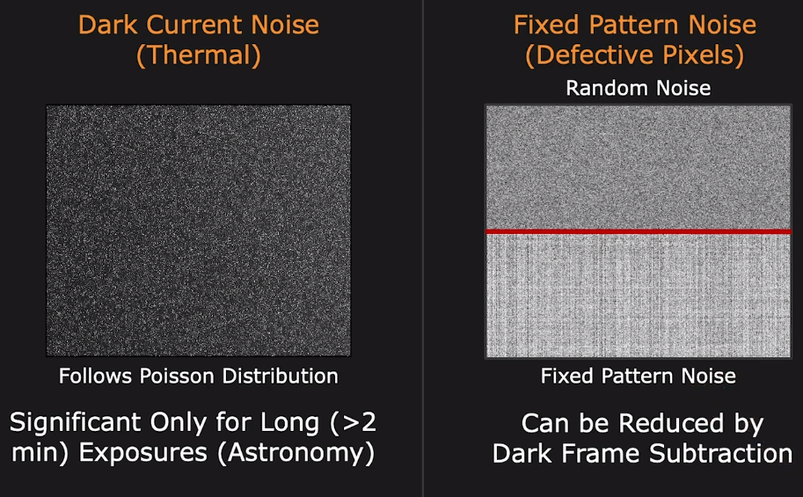
Image Noises

